Slide 1
Junior Division Plant Identification
State Floriculture CDE
February 4, 2017
Fort Valley State University

Slide 2
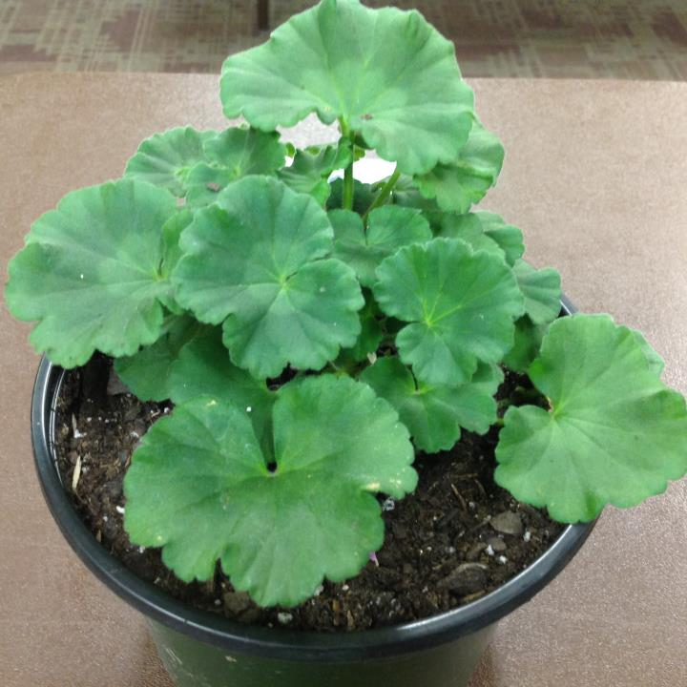
Geranium

Slide 3
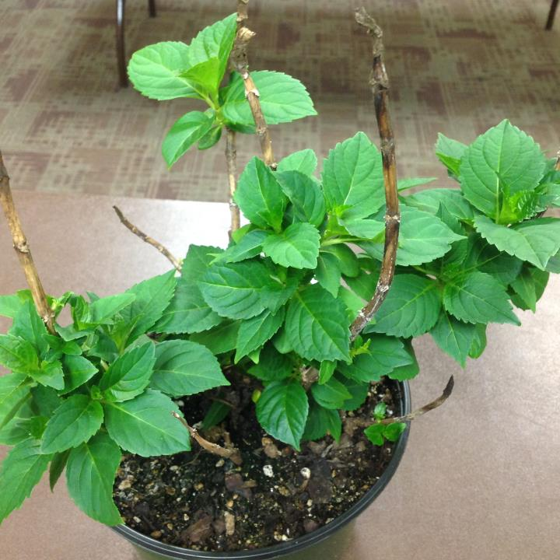
Hydrangea

Slide 4
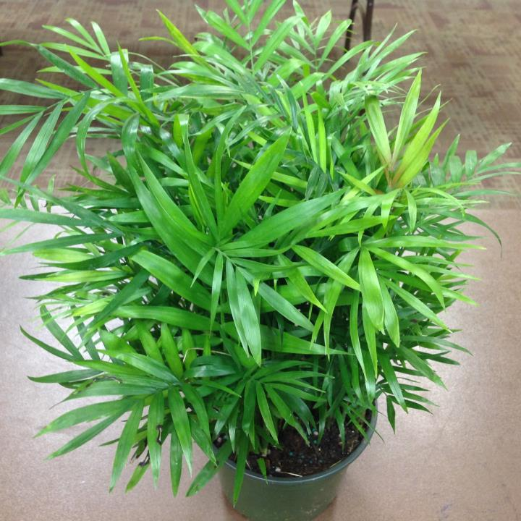
Parlor Palm

Slide 5
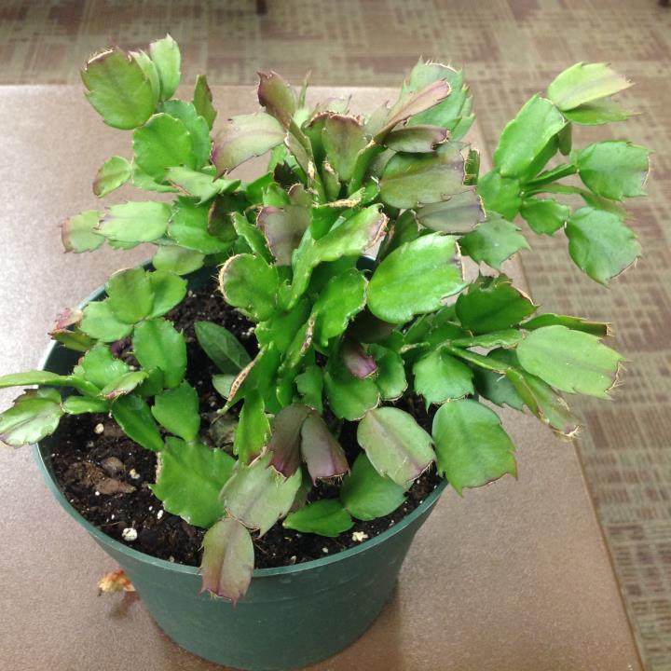
Thanksgiving Cactus

Slide 6
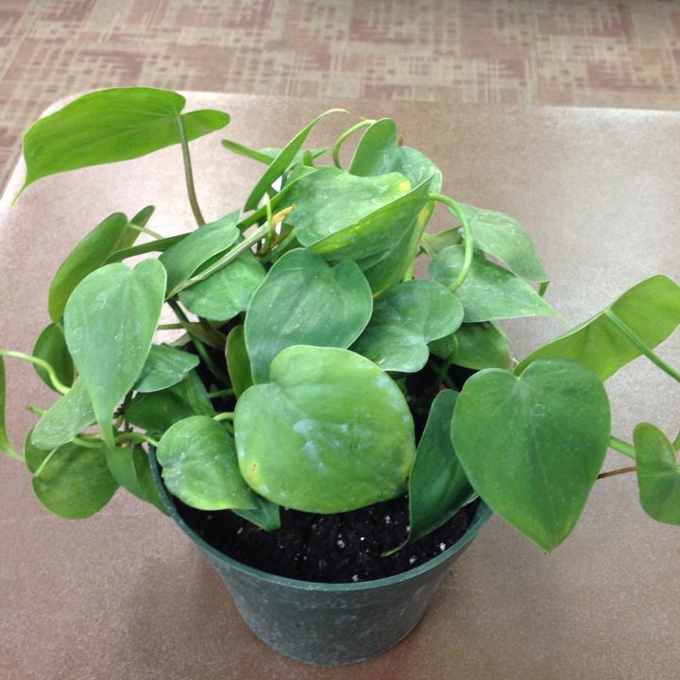
Heartleaf Philodendron

Slide 7
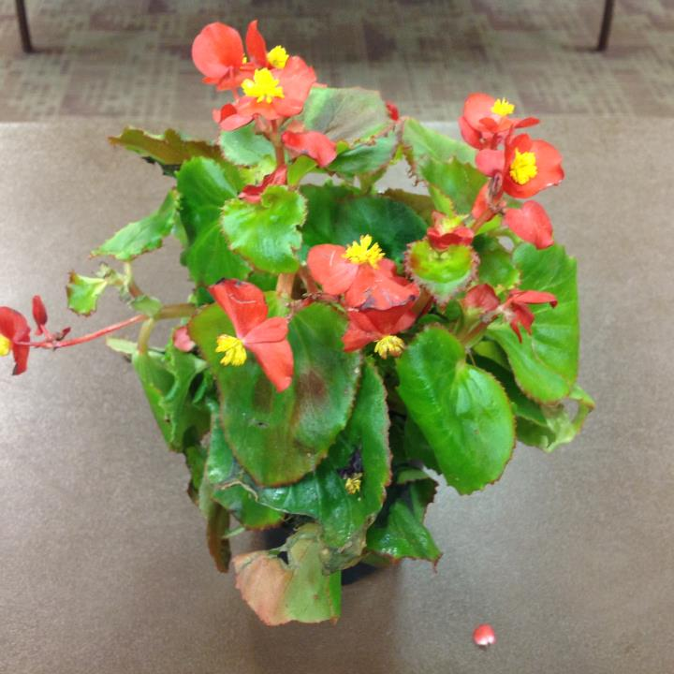
Wax Begonia

Slide 8
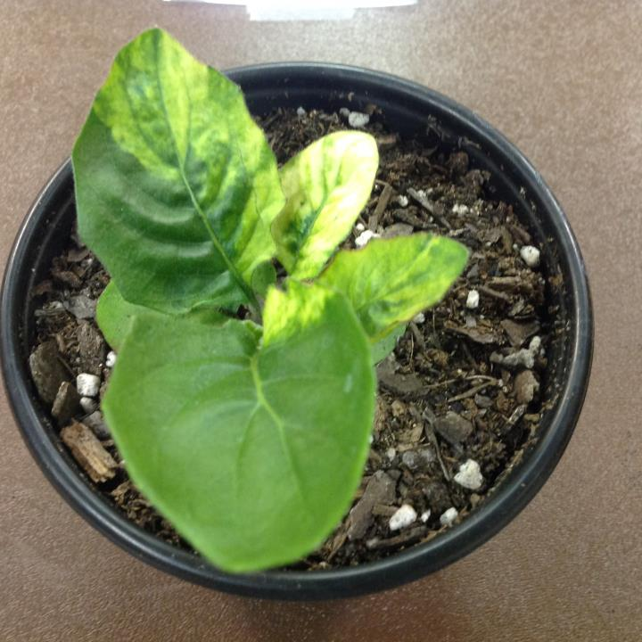
Gerbera Daisy

Slide 9
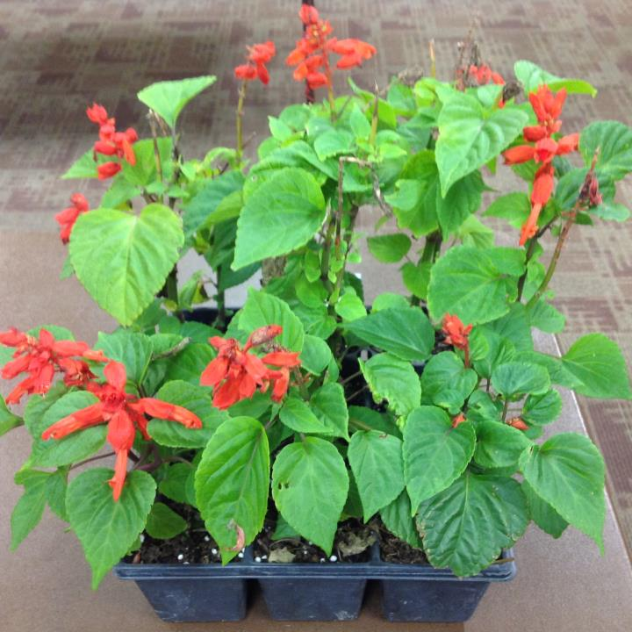
Salvia

Slide 10
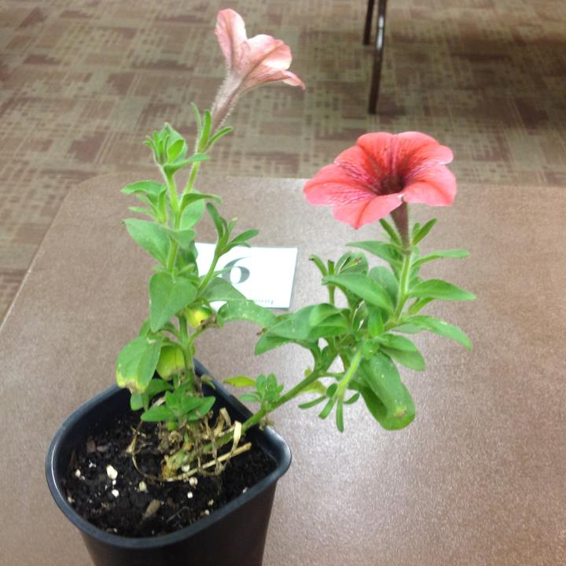
Petunia

Slide 11
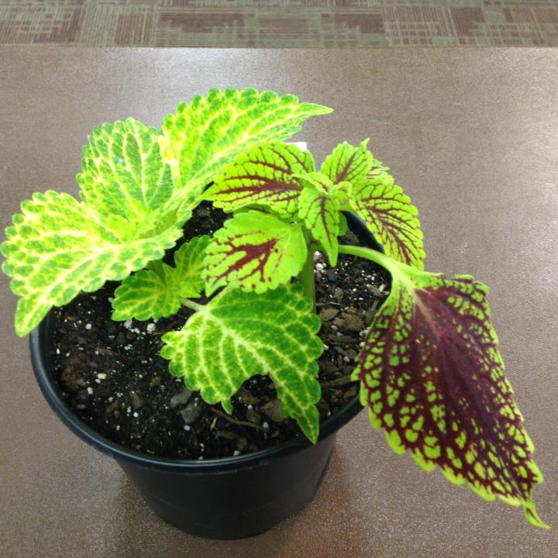
Coleus

Slide 12
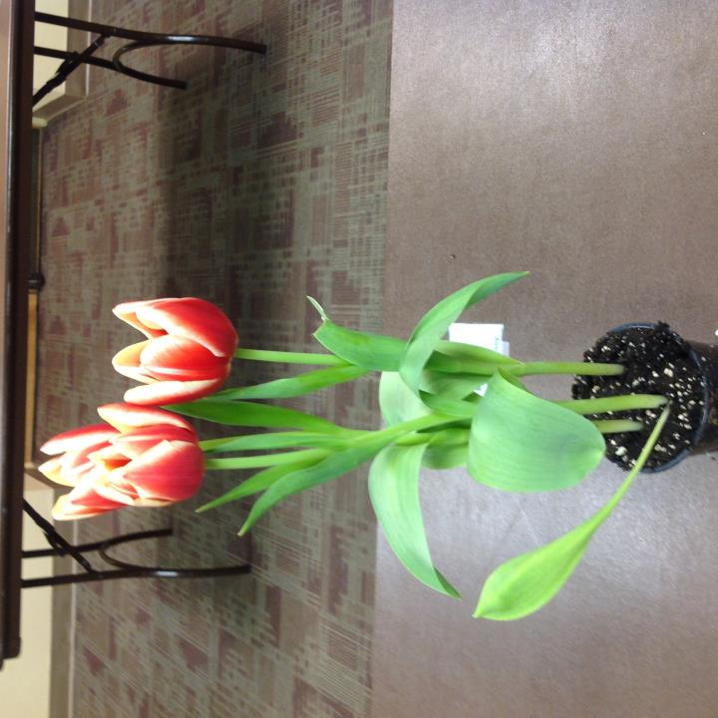
Tulip

Slide 13
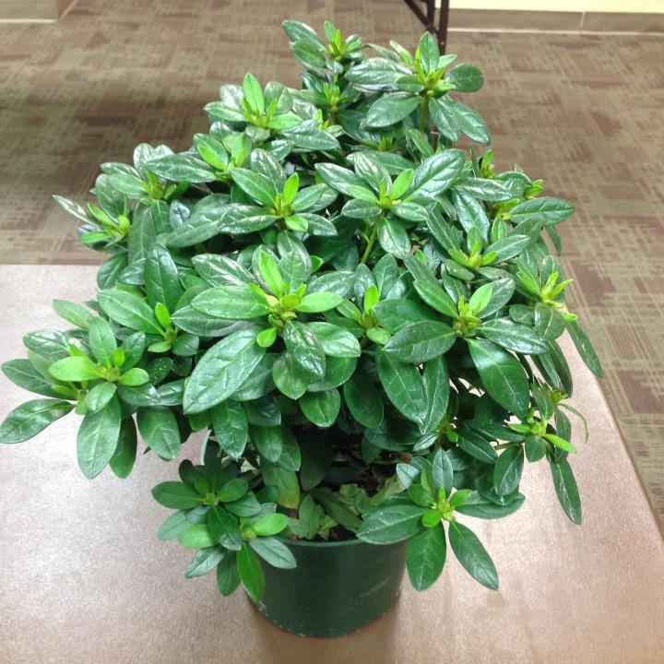
Azalea

Slide 14
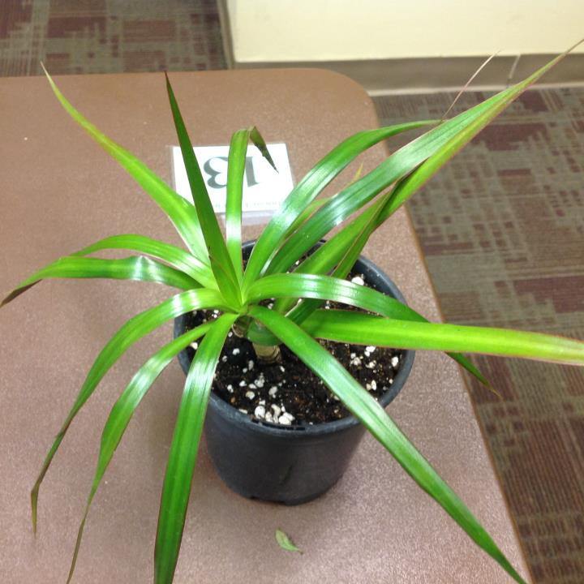
Red Edge Dracaena

Slide 15
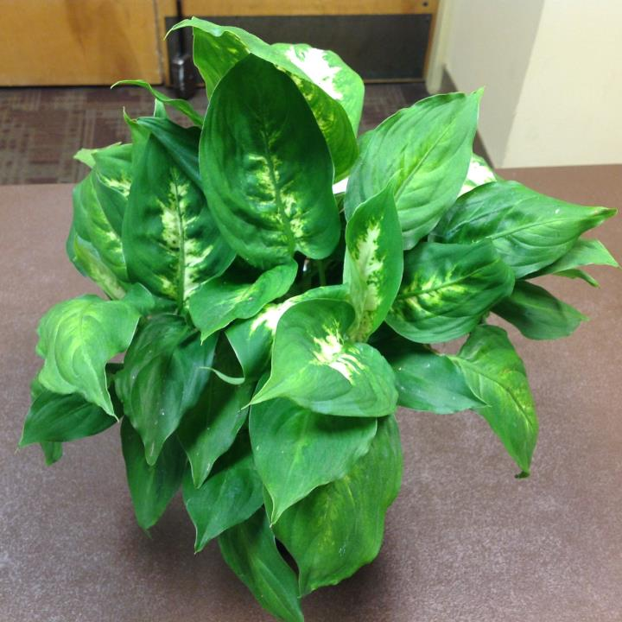
Dumbcane

Slide 16
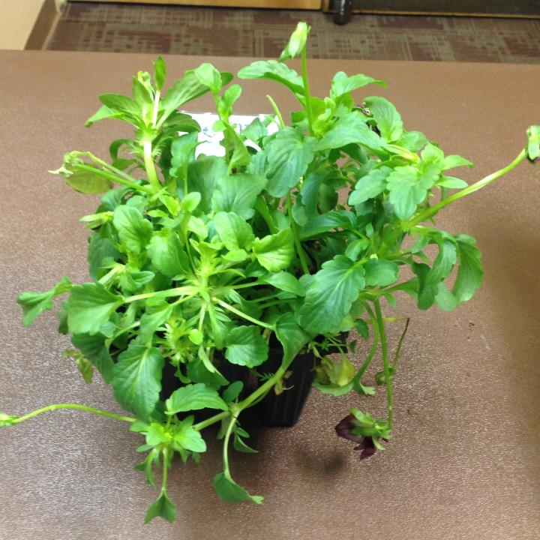
Pansy

Slide 17
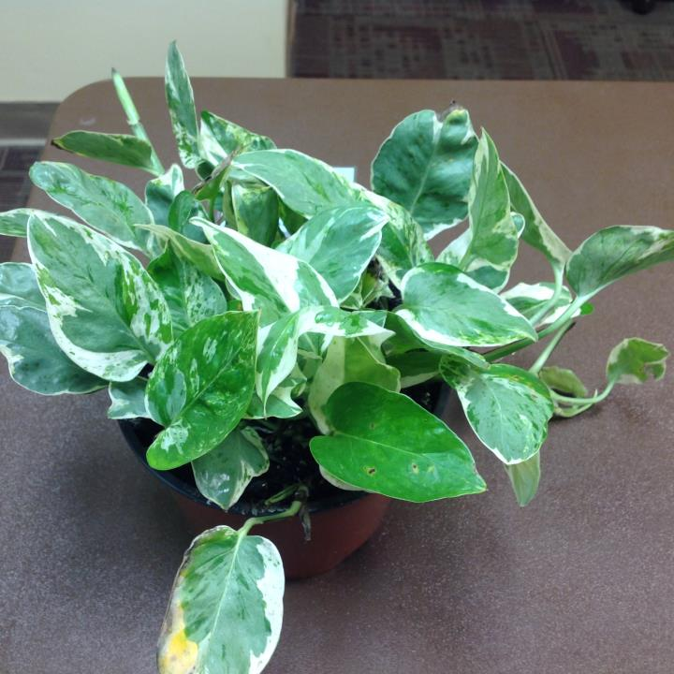
Pothos

Slide 18
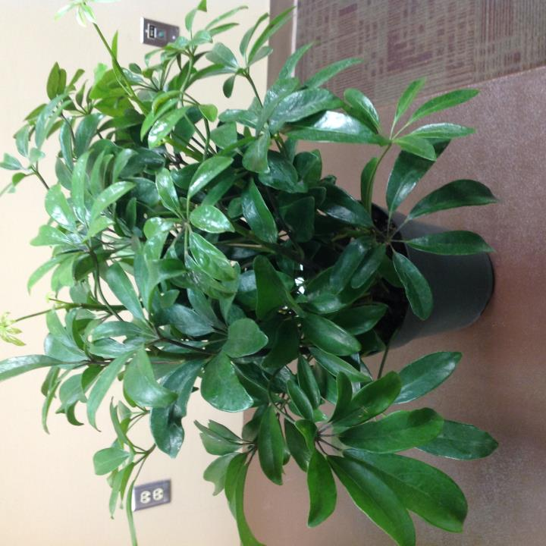
Dwarf Schefflera

Slide 19
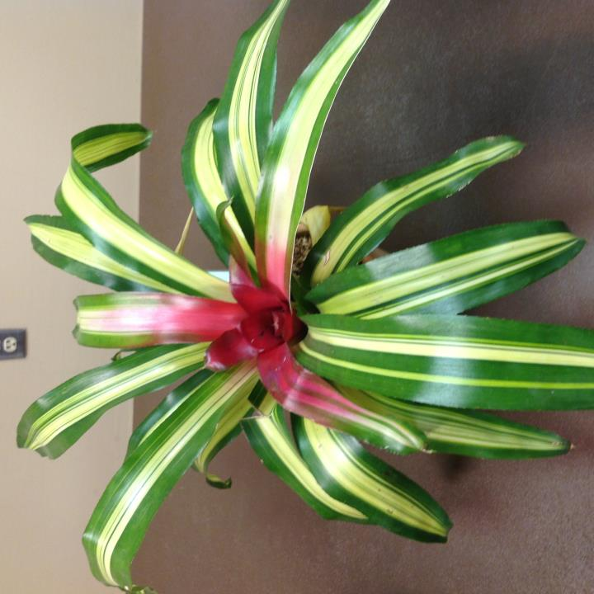
Tricolor Bromeliad

Slide 20
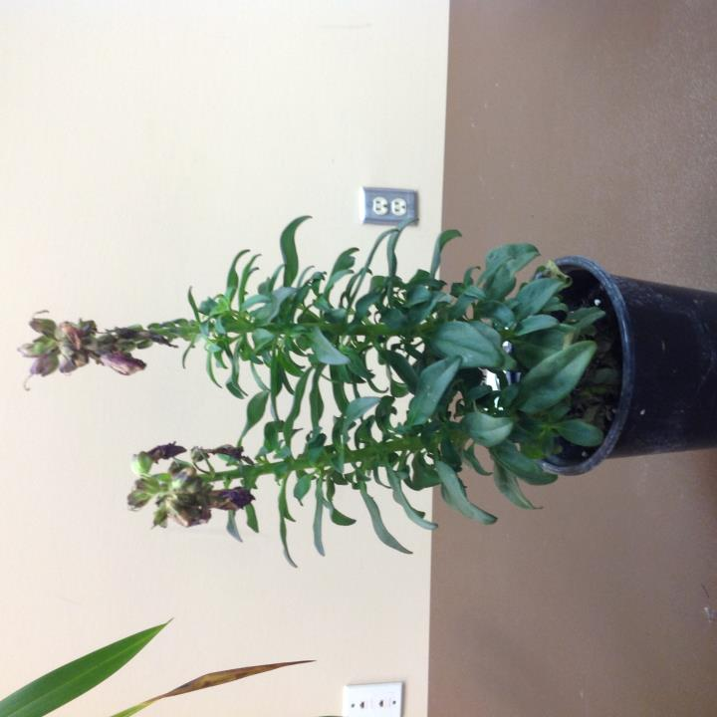
Snapdragon

Slide 21
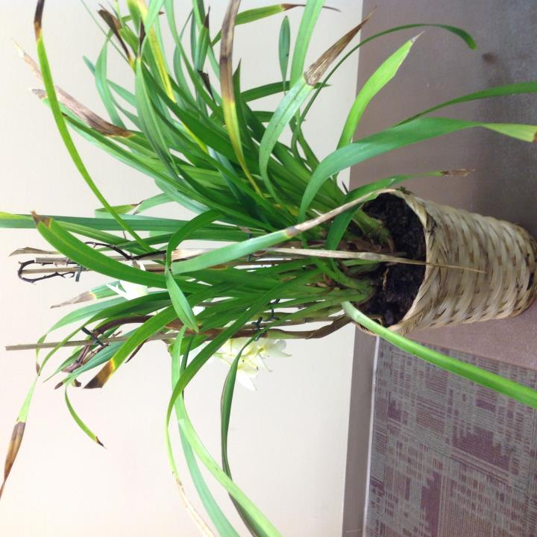
Cymbidium Orchid

Slide 22
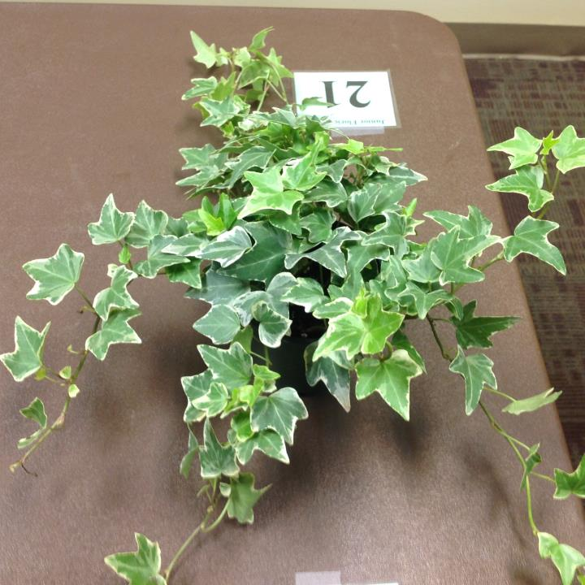
English Ivy

Slide 23
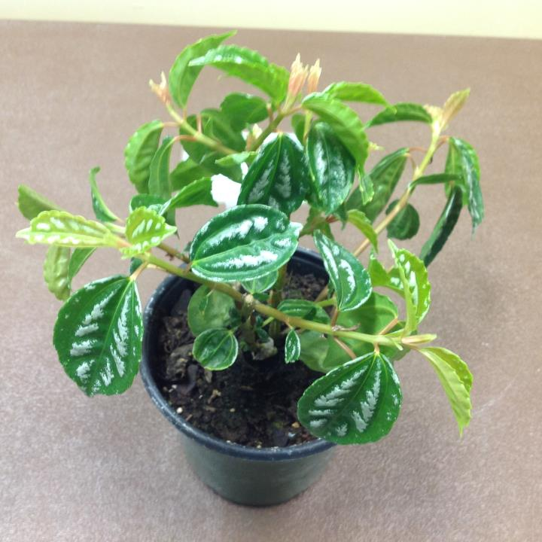
Aluminum Plant

Slide 24
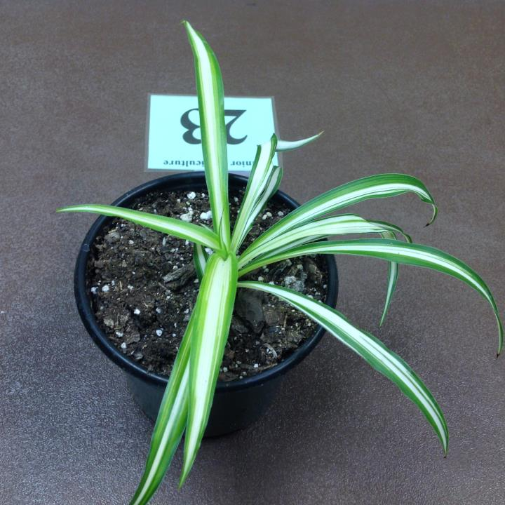
Spider Plant

Slide 25
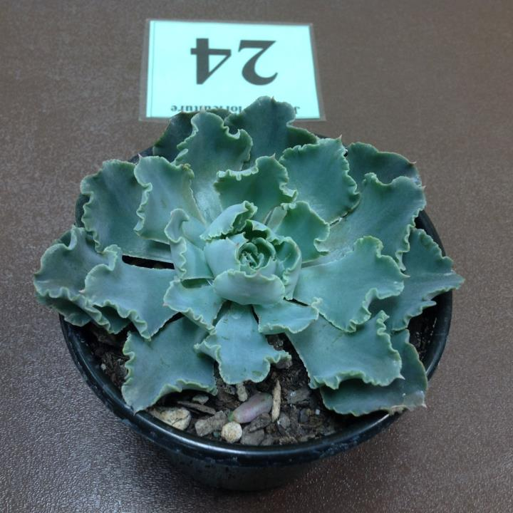
Hens And Chickens

Slide 26
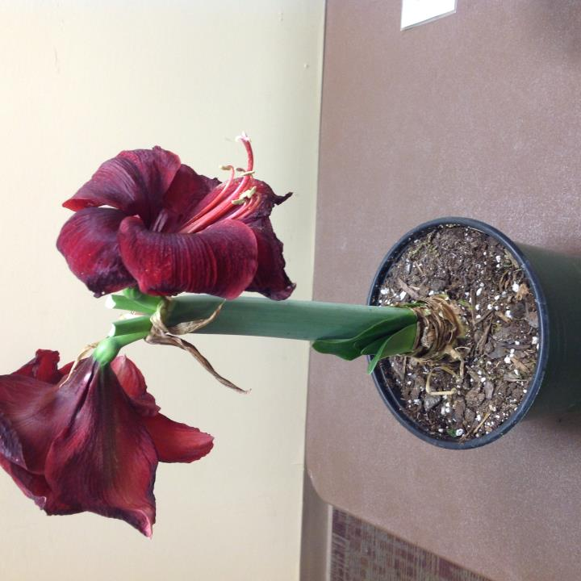
Amaryllis

